Slide 1
IOT BASED SMART BIN
Domain: IOT ( Internet OF Things)
Team members:
B.SINDHUMATHI
R.SNEKA

Slide 2
IOT – INTERNET OF THINGS
The Internet of Things is actually a pretty simple concept, it means taking all the things in the world and connecting them to the internet.
The Internet of Things (IoT) is a system of interrelated computing devices, mechanical and digital machines, objects, animals or people that are provided with unique identifiers and the ability to transfer data over a network without requiring human-to-human or human-to-computer interaction

Slide 3
Problem Statement:
Swachh Bharat Abhiyan and digital India is a campaign by the government of India to keep infrastructure of the country clean and to make the cities smarter. Day by day the population of India is growing rapidly. At the same time, the garbage also is growing at the same rate. As a result the garbage management is a problem that is quite hectic issue to solve.
The proposed project is quite helpful for both the Municipal Corporation and the citizens in that area by time to time interaction between Municipal Corporation and the proposed system. Hence the proposed system makes a better way to manage garbage.

Slide 4

Existing system:
The existing system is collection of garbage arbitrarily. So, some of the areas get left sometimes which may lead to unodoured smell and hence public health gets affected. The smell of the garbage can also be fatal to some of the little ones in some areas.
Also in existing system the employee has to login the website again and again to see the percentage of garbage filled.

Slide 5

Proposed system:
Once the level of the garbage reaches to a particular limit the system will give a notification to the particular authority via certain means. In case where the bins are already full or almost full, it will generate a warning message which will be sent to the municipality via notifications, by using the WI-FI module.
This will help them to actually know that where and when to go to collect the garbage. This manages the effort to check the area by visiting there. This project is quite helpful for both the Municipal Corporation and the citizens in that area. This establishes end to end communication.

Slide 6
Modules:
Phase 1 describes the initial state where the dustbin is not used. When the dustbin comes into the process and when the garbage are being overflowed as well as the garbage spills out then the device and sensors which is installed in it and then the threshold height is set. The bin is in the use by the users. Phase 2 starts as the threshold level is filled then the notification are then sent to the concerned authority via WiFi module. This notification is helpful to authority to take the actions for that particular dustbin. Phase 3 is the android application phase to back up the whole process as the acknowledgement. In Android application the percentage of garbage filled is shown.

Slide 7
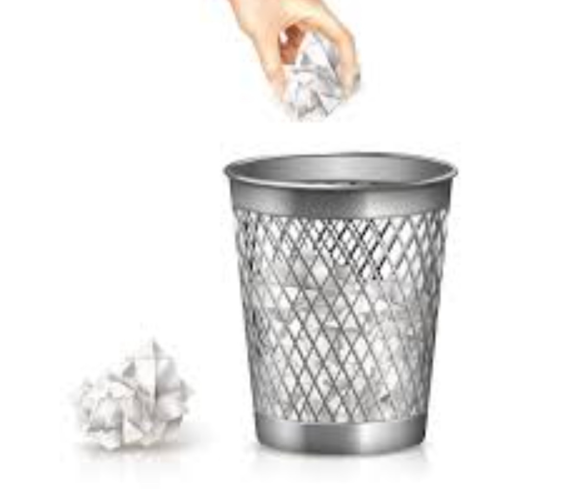
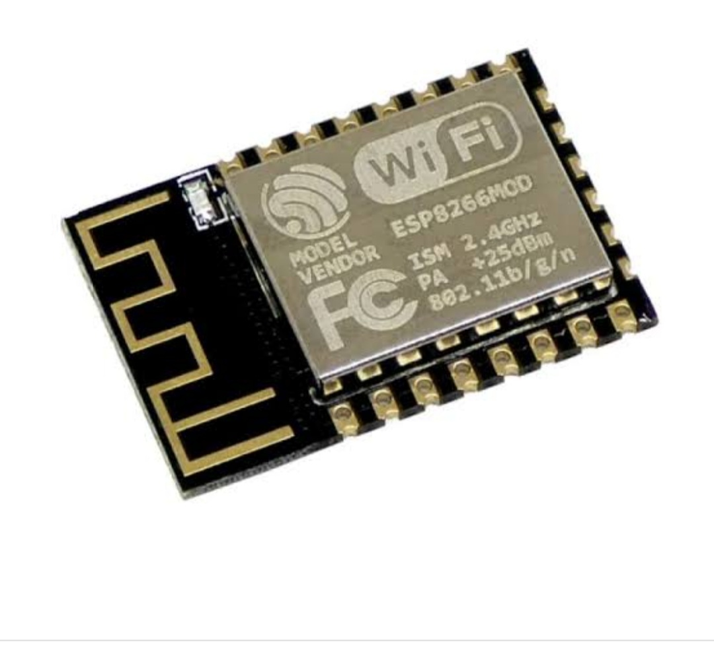
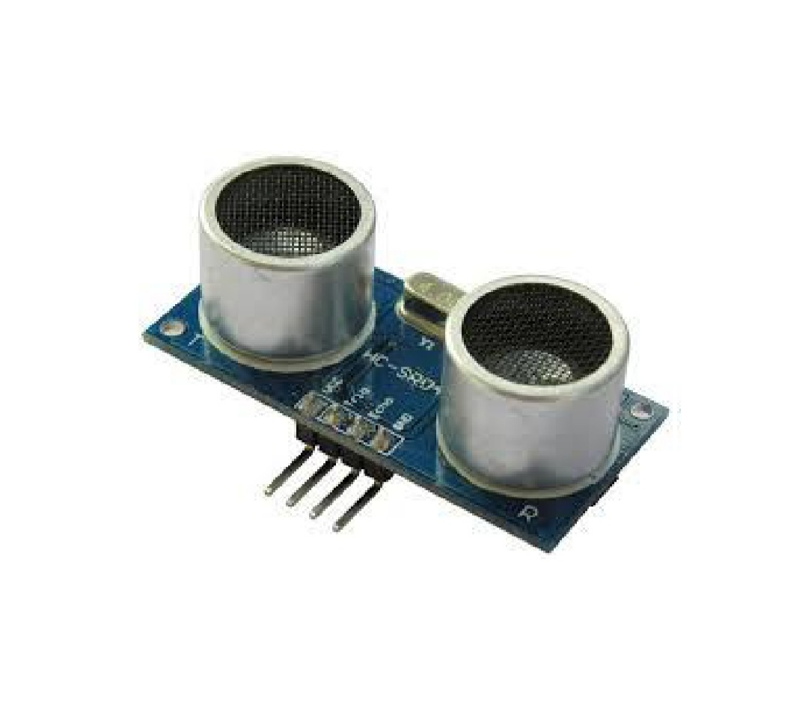
Working model:
Ultrasonic sensor wifi module
When the bins are almost full , the ultrasonic sensor senses and a warning message is sent to the employee’s phone using wifi module

Slide 8
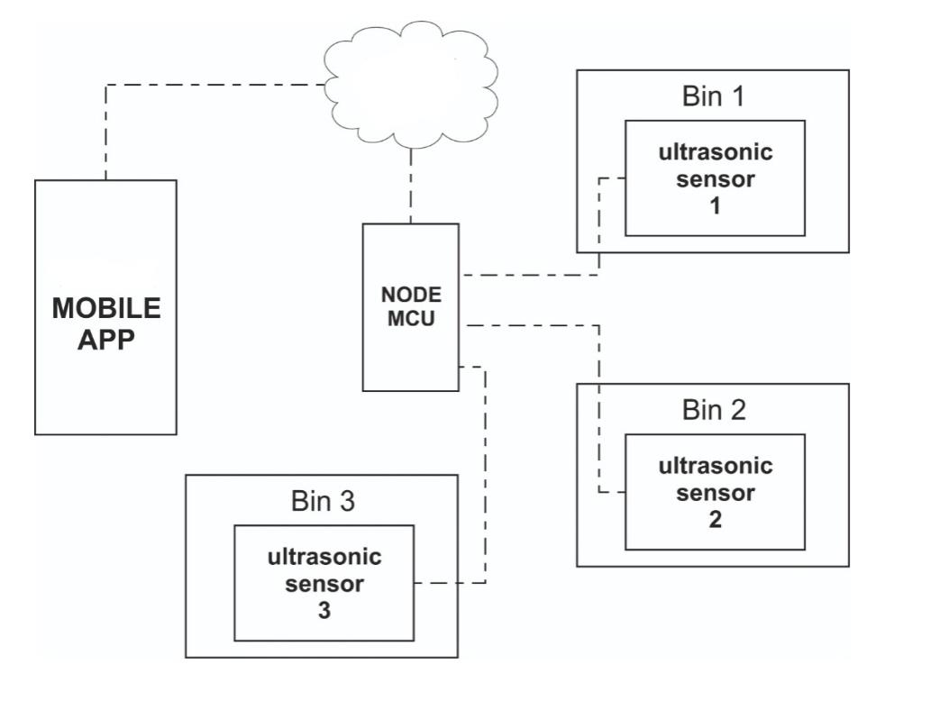
Block diagram:
CLOUD

Slide 9
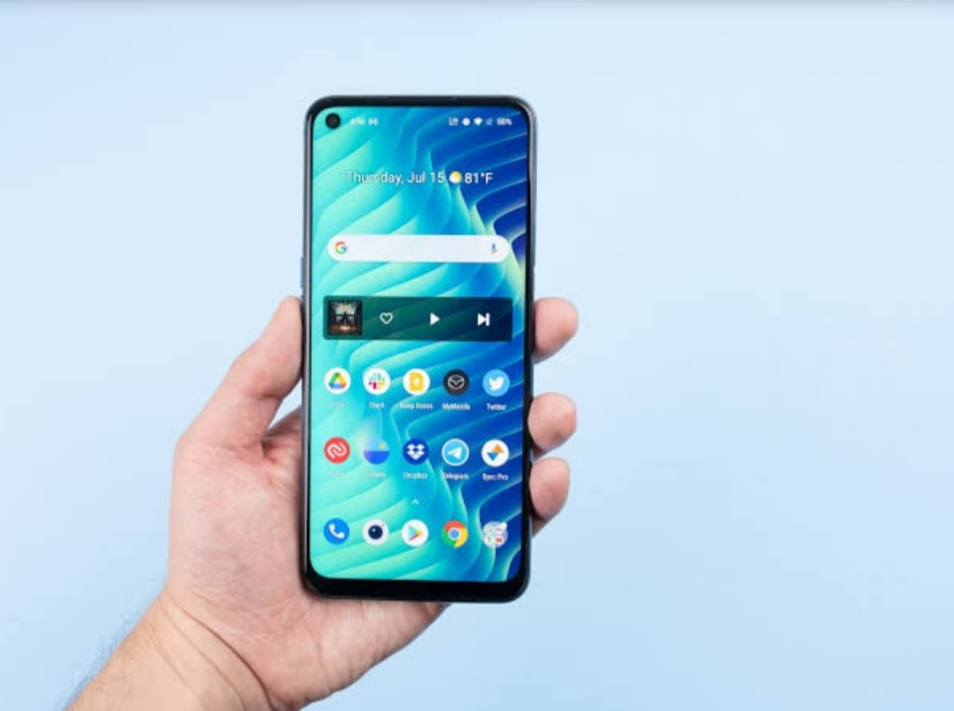
Software: code -> C Programming ( Arduino software)
C program is implemented to code the wifi module using Arduino software.
This connects the Municipal Corporation employee’s phone and the bin
To implement C program:
* Each employee’s Phone Id number
*Through mail id, an unique pin is generated for each employee.

Slide 10
BLYNK APPLICATION (FRAMEWORK)
Blynk is an IoT platform for iOS or Android smartphones that is used to control Arduino, Raspberry Pi and NodeMCU via the Internet. This application is used to create a graphical interface or human machine interface (HMI)
The process that occurs when someone presses the Button in the Blynk application is that the data will move to Blynk Cloud, where data magically finds its way to the hardware that has been installed.
There are three major components in the platform:
Blynk App: – It allows you to create amazing interfaces for your projects using various widgets which are provided.
Blynk Server: – It is responsible for all the communications between the smartphone and hardware.
Blynk Libraries: – It enables communication, for all the popular hardware platforms, with the server and process all the incoming and outcoming commands.

Slide 11
Libraries:
ESP8266WiFi.h - For WiFi Module
BlynkSimpleEsp8266.h - For connecting Blynk framework
These libraries should be downloaded so that connecting terms can be used in the programming.
Logic: The distance between the sensor and the garbage is detected through a formula and the duration ( assumption of time to get bin filled) is calculated

Slide 12
Benefits of proposed system:
This proposed system reduces the manpower as it doesn’t require daily travel of employees to the spot to check the garbage level.
This reduces daily scheduling of laborers by authorities.
FUTURE WORK:
Dry trash bin and wet trash bin collecting plastic dry waste and biodegradable waste can be installed as there will less complexity for separation and recycling of waste if any.

